Slide 1
Presentation on
“Convolutional Neural Network for Sentence Classification”
Presented By
Sohanoor Rahman
ID: 23273009
CSE713

Slide 2
Motivation/Purpose/Aims/Hypothesis
Explore the use of CNN in NLP
Aims to demonstrate that simple CNN can have better result
Potential gains in performance by fine-tuning and pre trained vectors
Motivated by the need of effectiveness and efficient models

Slide 3
Contribution
Proposes modification to the CNN architecture
With minimum hyperparameter, this paper still had excellent results
With compare to other model it performed remarkably
Showcasing the effectiveness of CNN model

Slide 4
Dataset
Movie Reviews datasets
Stanford Sentiment Treebank(SST-1)
Subjectivity dataset(Subj)
TREC question datasets
Customer reviews datasets
MPQA datasets

Slide 5
Methodology
One Layer CNN model
Pre-trained word vector from word2vec
Three variants of model
Model architecture allows the use of both pre-trained and task-specific vector.
Model achieve excellent result on multiple benchmark

Slide 6
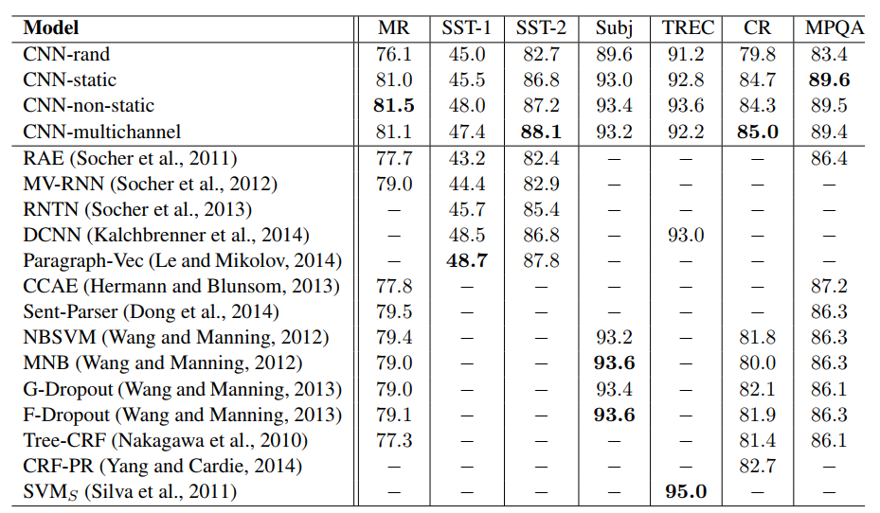
Results and Conclusion

Slide 7
Limitation
Limitation I
First limitation is the lack of extensive hyperparameter tuning. It was mentioned in the paper that the models were giving excellent result on fewer hyperparameter tuning. Which may raise a question about the robustness and generalizability of the models.
Limitation II
The comparison with other established models is limited. Albeit the study highlights advances on 4 out of 7 tasks above the state of the art, it does not offer a thorough comparison with other models that are already in use.

Slide 8
Synthesis
Improved Sentence Classification
Fine-tuning and Task-specific Vectors
Generalization to different domains
Comparison with other models

Slide 9
Thank You!

